Slide 1
C# Game
Sam Bowden-Williams

Slide 2
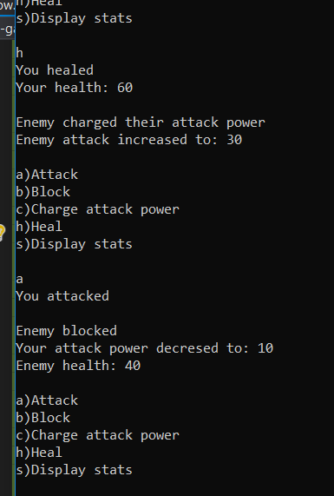
Development
Console version
OOP
Importing to WPF

Slide 3

Challenges
Large amount of conditions
Applying OOP to WPF

Slide 4
Future sprint
Character creation
Levels
Graphical improvements

Slide 5
Any Questions?

